Slide 1
Problem Solving Using Control Structures – II

Slide 2
Objectives
Code Snippets on Looping Control Structures
Programs (problem Solving using Loops).

Slide 3
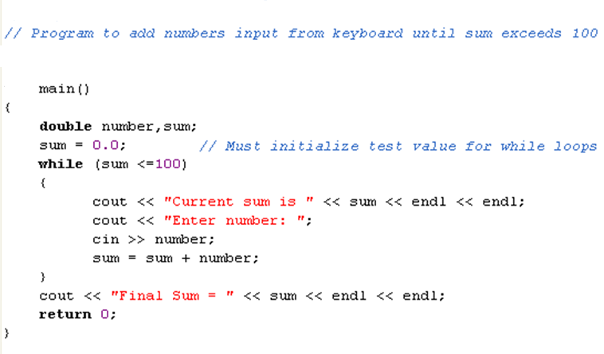
Example Program
Notes:
(c) z: 0
(d) y: 0 z: 1

Slide 4
Program to find the average marks scored for unknown number of students in 3 subjects and display whether passed or failed ( average passing marks is 65).
char cChoice = 'y';
float fMark1,fMark2,fMark3;
while( (cChoice == 'Y') || (cChoice == 'y') ) {
cout<<"Enter the marks scored by the student in 3 subjects\n";
cin>>fMark1>>fMark2>>fMark3;
fSum = fMark1 + fMark2 + fMark3;
fAvg = fSum / 3;
if ( fAvg >= 65.0)
cout<<"Student PASSED\n";
else
cout<<"Student FAILED\n";
cout<<"Do you wish to continue? Enter Y/N or y/n :";
cin>>cChoice; //cChoice = getch();
}

Slide 5
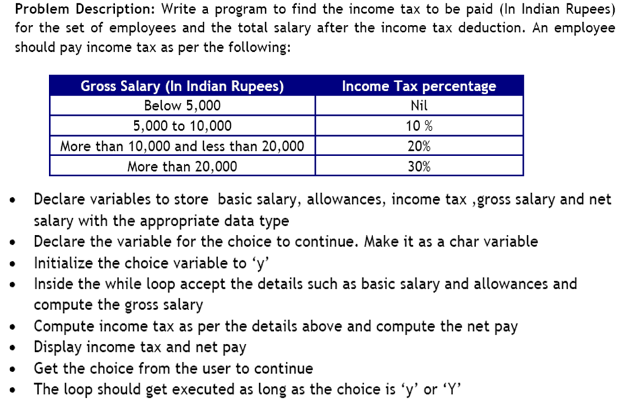
To understand while loop

Slide 6
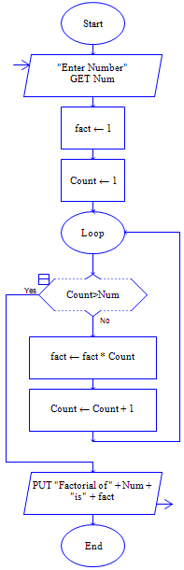
Compute factorial of a number
Algorithm: Factorial of a Number
Step1: Input Num
Step 2: fact ←1
Step 3: For count=1 to Num in step of 1 do
begin
fact ← fact * count
count ← count + 1
end
Step 4: Print ‘fact of Num=‘, fact
Step 5: [end of algorithm]
Stop

Slide 7
Program to find the factorial of a num
#include <iostream.h>
#include <conio.h>
void main( )
{
int num;
int count, fact;
fact =1;
clrscr();
cout<<“Enter a value for num : “;
cin>>num;
for(count = 1; count<=num; count ++)
{
fact = fact * count;
}
cout<<“Factorial of “<<num<<“ = “<<fact;
getch();
}

Slide 8
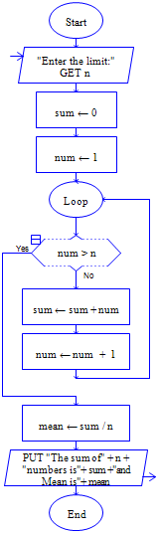
Find the sum and mean of first N natural numbers
Algorithm: sum and mean of natural numbers.
Step1: Input N
Step 2: Sum ← 0
Step 3: for Num=1 to N in step of 1 do
begin
Sum ← Sum + Num
end
Step 4: Mean ← Sum / N
Step 5: Print ‘Sum of N natural numbers=‘,Sum
Print ‘Mean of N natural numbers =‘,Mean
Step6: [End of algorithm]
Stop

Slide 9
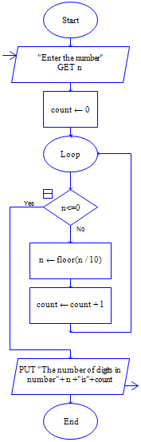
Algorithm to count the no of digits of a number
Algorithm: count the no of digits.
Step 1: input N
Step 2: count ← 0
Step 3: while N > 0
begin
N←N/10 (integer)
count← count + 1
end
Step 4 : Print ‘count=‘, count
Step 5: : [End of Algorithm]
STOP

Slide 10
Algorithm to calculate sum of digits of a number
Algorithm: find sum of digits of a number
Step 1: Input N
Step 2: sum←0
Step 3: while N > 0
begin
rem ← N mod 10
sum← sum + rem
N←N/10 (integer)
end
Step 4: print sum
Step 5 :[End of Algorithm]
Stop

Slide 11
Algorithm and Program for Fibonacci series
Algorithm : Fibonocci Series
Step 1 : Input Limit
Step 2: First←0,Second←1
Step 3: print First
Step 4: while Second < Limit
begin
Print Second
Next← First + Second
First←Second
Second← Next
end
Step 5:[End of Algorithm]
Stop
#include<iostream.h>
#include<conio.h>
void main() {
clrscr();
int first=0, second=1, limit, next;
cin>>limit;
cout<<first;
while(second < limit) {
cout<<second;
next = first + second;
first = second;
second = next;
} getch();
}

Slide 12
Read an integer N and print the first N Fibonacci numbers. [Hint: for N=7; Fibonacci series is 0, 1, 1, 2, 3, 5, 8]
#include<iostream.h>
#include<conio.h>
void main() {
clrscr();
int a=0,b=1,c=0,n;
cout<<"Enter the number of terms: ";
cin>>n;
cout<<a<<" "<<b<<" ";
for(int i=1;i<=n-2;i++)
{
c=a+b;
a=b;
b=c;
cout<<c<<" ";
}
getch();
}

Slide 13
Example: Convert binary to decimal
dec = bd*2^{n} + bd*2^{n-1} + … + bd*2¹ + bd*2⁰
e.g.-given n=101 → 1*2² + 0*2¹ + 1*2⁰ = 5
------------------------------------------------------------------------------------
int n, p=0, sum=0, k;
cout<<“Enter a binary number : “;
cin>>n;
do {
k=n%10; // binary number in n
sum= sum + k * pow(2,p);//decimal number in sum
p++;
n= n/10;
} while (n!=0);
cout<<“Decimal Equivalent = “ <<sum;

Slide 14
Count the even and odd digits in a given ‘n’ digit number
cin>>num;
while(num > 0)
{
rem=num%10;
num/=10;
if(rem%2==0)
ecnt++;
else
ocnt++;
}
cout<<ecnt<<" even & "<<ocnt<<" odd digits ;
e.g.- num = 31467
OUTPUT
2 even & 3 odd digits

Slide 15
Reverse an ‘N’ digit number
Output:
N= 1234
Rev=4321
int rev=0;
cin>>n;
while(n!=0)
{
rev = (10 * rev) + n%10;
n = n/10;
}
cout<<”Reversed no.="<<rev;

Slide 16
Check for palindrome
Palindrome (number)
e.g.- 121
n = num;
while(num>0)
{
dig = num % 10;
rev = rev * 10 + dig;
num = num / 10;
}
if (n == rev)
cout<<"\n\t GIVEN NUMBER IS A PALINDROME";
else
cout<<"\n\t GIVEN NUMBER NOT A PALINDROME";

Slide 17
Armstrong nos for a given limit ‘n’
cin>>lim;
for(n=1;n<lim;n++)
{
sum = 0;
num = n;
while(num>0)
{
dig = num%10;
sum = sum+pow(dig,3);
num = num/10;
}
if(sum == n)
cout<<"\n\t"<<n;
}
Armstrong Number
e.g. - 371
∑ (cubes of digits )= number
3³ + 7³ + 1³ = 371

Slide 18
Prime series between 2 limits
for( int i=n; i<=m; i++){
prime=0;
for( int j=2; j<= i/2; j++ ) {
if( i % j == 0){
prime=1;
break; /* break out of inner loop */
}
}
if(prime == 0)
cout<< i <<"\t";
}
Prime series
2, 3, 5, 7, 11,…

Slide 19
Program to print Floyd’s triangle
void main(){
clrscr();
int i,j,r,k=1;
cout<<"Enter the range: ";
cin>>r;
cout<<"FLOYD'S TRIANGLE\n\n";
for(i=1;i<=r;i++){
for(j=1;j<=i;j++,k++)
cout<<k;
cout<<"\n";
}
getch();
}
Floyd’s triangle
1
2 3
4 5 6
7 8 9 10

Slide 20

Program to print ASCII Value of all characters
int i;
char c;
for(i=0;i<=255;i++)
{
c=i;
cout<<“ASCII value of character ”<<c<<” :”
<<i<<“\n”;
}
Output:
.
.
.
.
.
.

Slide 21
To be solved …
Write a program to
Program to generate ‘n’ prime numbers.
Read a positive number N. Then read N integers and print them out together with their sum [for inside while].
Read an integer N. Print out if it is a prime or not. If not, print out all of its proper factors. [Hint: 3 is a prime; non-trivial factors of 6 are 2 & 3]
Compute the squares of N successive integers without using multiplication.

Slide 22
Summary
Simple Programs on looping control structures
Problem solving using various looping control structures

